Slide 1



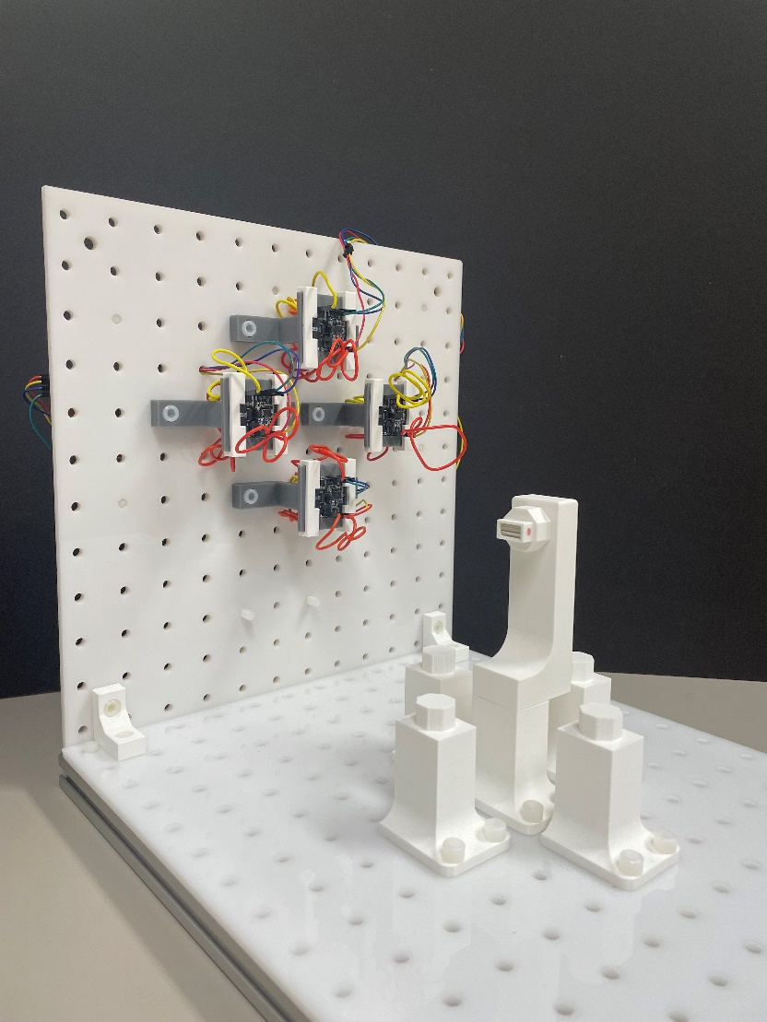
Optimizing Planar Arrays of Magnetic Sensors for Medical Robot Localization
Xiaowei Lin
Supervisors:
Prof. Dr. Pierre E. Dupont Prof. Dr. Giovanni Pittiglio
Prof. Dr. Bradley J. Nelson
Master’s Thesis Presentation
October 11th , 2024

Slide 2
Index
Motivation
Problem definition
Proposed approach
Magnetic field model
Gauss-Newton on manifold algorithm
Optimization of the sensor configuration
Experiments
Conclusion and outlooks

Slide 3
Index
Motivation
Problem definition
Proposed approach
Magnetic field model
Gauss-Newton on manifold algorithm
Optimization of the sensor configuration
Experiments
Conclusion and outlooks

Slide 4
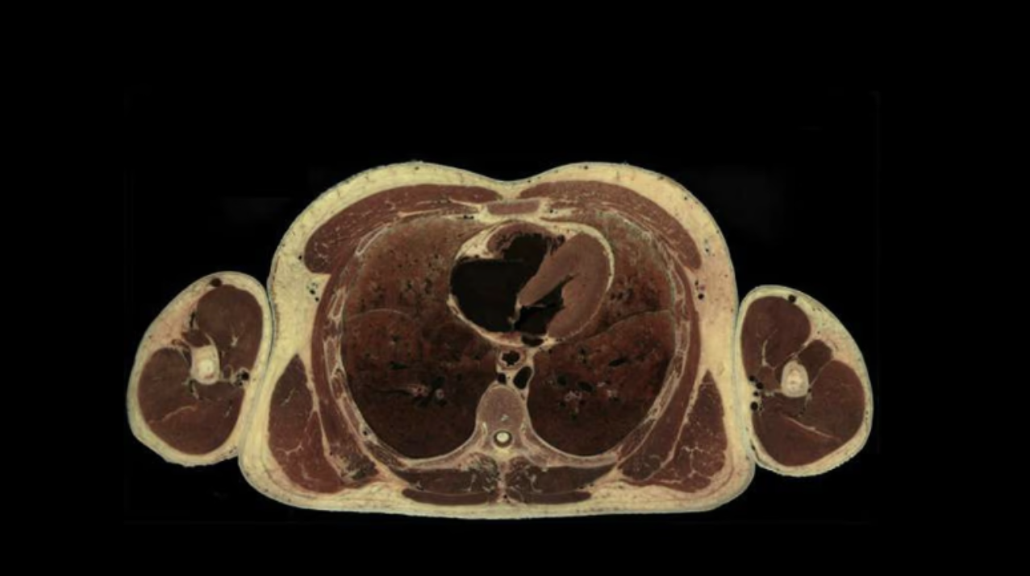
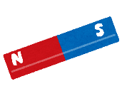
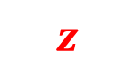
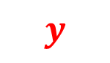
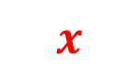
Motivation
$$z$$
$$y$$
$$x$$
Notes:
Imagine a patient lying on the operating bed and this is the coronal plane of the patient. A robotic catheter is operating in the patient’s heart. To achieve good control, it is beneficial to have an idea of the shape of the catheter. This can be done by inserting a optic fiber into the catheter and use the light deflection to sense the shape. But this method is very costly. Another approach can be mounting a magnet at the top of the catheter, which is tracked by a system of magnetic sensors. By localization the magnet, we can back calculate the shape of the catheter using some modeling technique, such as a constant curvature model. So, we are interested in tracking the magnet’s configuration using an array of the magnetic sensors mounted on the operating bed.

Slide 5
Index
Motivation
Problem definition
Proposed approach
Magnetic field model
Gauss-Newton on manifold algorithm
Optimization of the sensor configuration
Experiments
Conclusion and outlooks

Slide 6
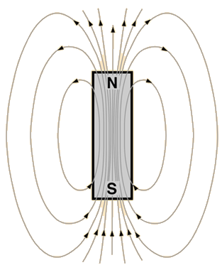
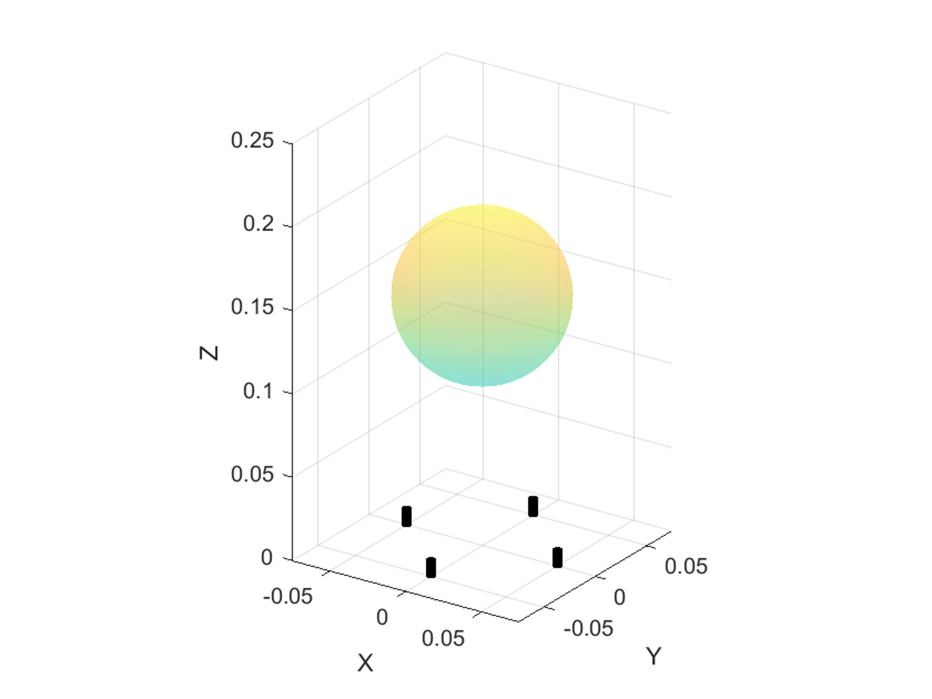
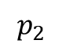
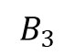
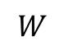
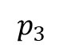
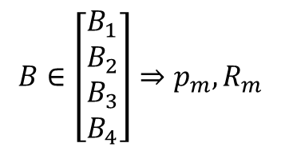
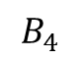
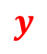
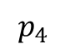
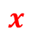
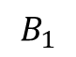
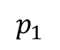

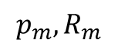
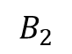
Problem definition
$$p_{m}, R_{m}$$
$$B_{2}$$
$$B_{3}$$
$$z$$
$$p_{2}$$
$$B_{1}$$
$$y$$
$$W$$
$$p_{3}$$
$$B_{4}$$
$$p_{1}$$
$$x$$
$$p_{4}$$
$$B∈\left[\begin{matrix}B_{1} \\ B_{2} \\ \begin{matrix}B_{3} \\ B_{4}\end{matrix}\end{matrix}\right]⇒p_{m},R_{m}$$
Notes:
Let’s define the problem in detail. This is the setup we are interested in. We model the heart as the spherical workspace whose diameter is 10cm and the bottom is 10cm away from the sensor array. It resembles the dimension of a human body. The magnet is modeled as a magnetic dipole, generating the magnetic field. The magnet has a local frame attached to it, representing its configuration, position and orientation. The z-axis of the local frame is aligned with the magnet’s dipole direction, pointing from the south to north pole. The magnetic field is captured by a number of sensors placed on the operating bed, whose coordinate frames are aligned with the world frame. It simplifies the problem because we can easily express everything with respect to the world frame. Given the measured magnetic field, we are interested in solving the magnet configuration. It’s a 5DOF system because the rotation around the z-axis of a magnetic dipole does not change the magnetic field. To solve a 5DOF system, at least 5 measurements of the magnetic field is required, leading to at least two 3-axis sensors.

Slide 7
Index
Motivation
Problem definition
Proposed approach
Magnetic field model
Gauss-Newton on manifold algorithm
Optimization of the sensor configuration
Experiments
Conclusion and outlooks
Notes:
. Then we look into how to optimize the performance of the inverse algorithm by manipulating the sensor configuration. Finally, experiments is conducted to compare different sensor configuration.

Slide 8
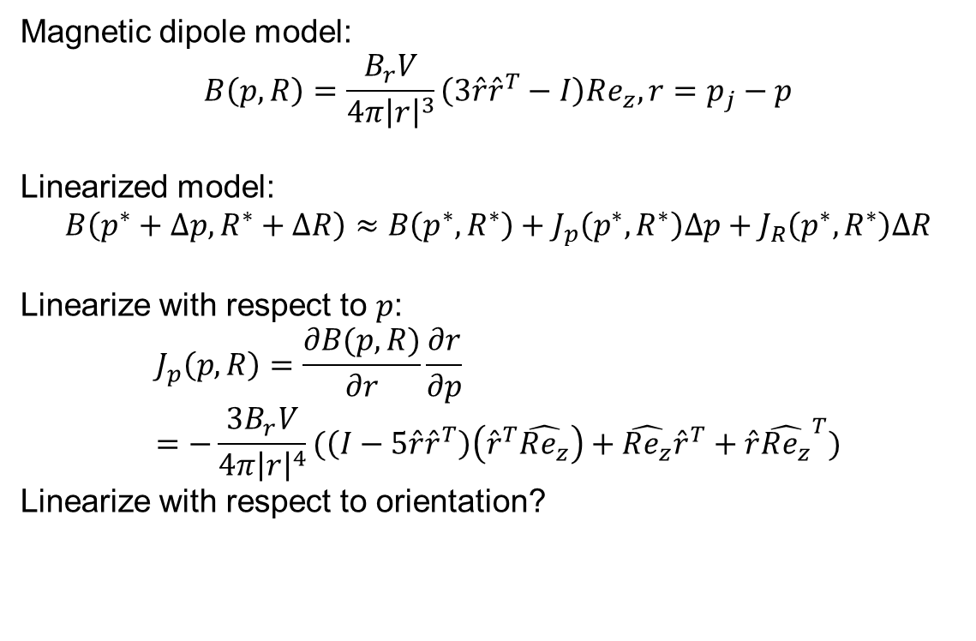
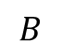
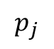
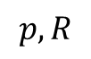
Magnetic dipole model and its linearization
Magnetic dipole model:
$$B\left(p, R\right)=\frac{B_{r}V}{4π{\left|r\right|}^{3}}\left(3\hat{r}{\hat{r}}^{T}−I\right)Re_{z}, r=p_{j}−p$$
Linearized model:
$$B\left(p^{∗}+Δp, R^{∗}+ΔR\right)≈B\left(p^{∗},R^{∗}\right)+J_{p}\left(p^{∗},R^{∗}\right)Δp+J_{R}\left(p^{∗},R^{∗}\right)ΔR$$
Linearize with respect to $p$:
$$J_{p}\left(p,R\right)=\frac{∂B(p,R)}{∂r}\frac{∂r}{∂p}=−\frac{3B_{r}V}{4π{\left|r\right|}^{4}}(\left(I−5\hat{r}{\hat{r}}^{T}\right)\left({\hat{r}}^{T}\hat{Re_{z}}\right)+\hat{Re_{z}}{\hat{r}}^{T}+\hat{r}{\hat{Re_{z}}}^{T})$$
Linearize with respect to orientation?
$$p, R$$
$$B$$
$$p_{j}$$
Notes:
To solve the inverse problem from the magnetic field to the magnet’s configuration, we first need to look into how the magnetic generates the magnetic field. The magnetic field generated by a magnet with certain configuration, p and R, at a position p_j is given by the dipole model, which is highly nonlinear and difficult to analyze. We are interested in approximating the nonlinear model with a linear function. There are two reasons for this: first, we can use the knowledge of linear algebra to analyze the linear model; second, the linear model is effectively used in the algorithm that solves the inverse problem. The linearization assumes the parameters live in the Euclidean space and it’s trivial for position because position exactly lie in the Euclidean space and it can be parametrized using the Euclidean coordinates. The Jacobian can be calculated using the chain rule.

Slide 9
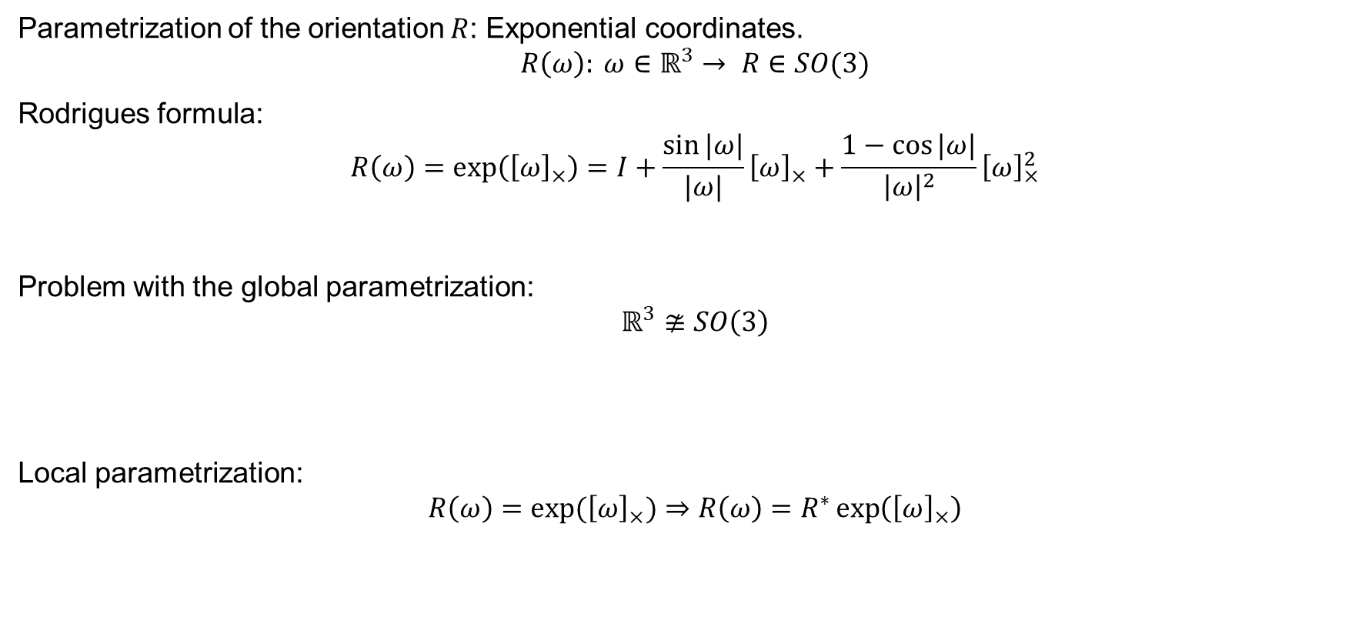

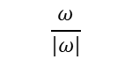
Linearize with respect to orientation
Parametrization of the orientation $R$: Exponential coordinates.
$$R\left(ω\right): ω∈ℝ^{3}→ R∈SO(3)$$
Rodrigues formula:
$$R\left(ω\right)=\exp\left({\left[ω\right]}_{×}\right)=I+\frac{\sin{|ω|}}{|ω|}{\left[ω\right]}_{×}+\frac{1−\cos{|ω|}}{{\left|ω\right|}^{2}}{\left[ω\right]}_{×}^{2}$$
Problem with the global parametrization:
$$ℝ^{3}≇SO\left(3\right)$$
Local parametrization:
$$R\left(ω\right)=\exp{({\left[ω\right]}_{×})}⇒R\left(ω\right)=R^{∗}\exp\left({\left[ω\right]}_{×}\right)$$
$$\frac{ω}{|ω|}$$
$$|ω|$$
Notes:
However, the orientation lies in the Lie group SO(3), which is not a Euclidean space. To compute the linearization with respect to orientation, we need to find some parametrization of the rotation that lies in the Euclidean space, such as the exponential coordinates. The exponential coordinate is a vector in R3, which can be used in linearization and it’s mapped to the space of SO(3) using the Rodrigues formula. It’s a global parametrization, mean the origin of exponential coordinate corresponds to the Identity in SO(3). However, because the Euclidean space R3 is not isomorphic to SO(3), all of these global parametrization, including exponential coordinates or Euler angles suffer from singularity or other anomalies in various points in the parameter space. An example is that when you calculate the Jacobian of the magnetic field with respect to the exponential coordinate, the null-space of that matrix does not correspond to a z-axis rotation. It means that z-axis rotation change the magnetic field, which is not physically correct. It prevents us from analyzing the behavior using the linear model and it will cause serious problem when using the linear model to solve for the magnet’s configuration, which will be introduced later.
To solve this issue, a local parametrization is used. Namely, at the interested rotation R_star, for example the linearization point, move the origin of the exponential coordinate to R_star by pre-multiplying it to the mapping. Now the origin omega=0 corresponds to orientation=R*. This is why it’s called a local parametrization.

Slide 10
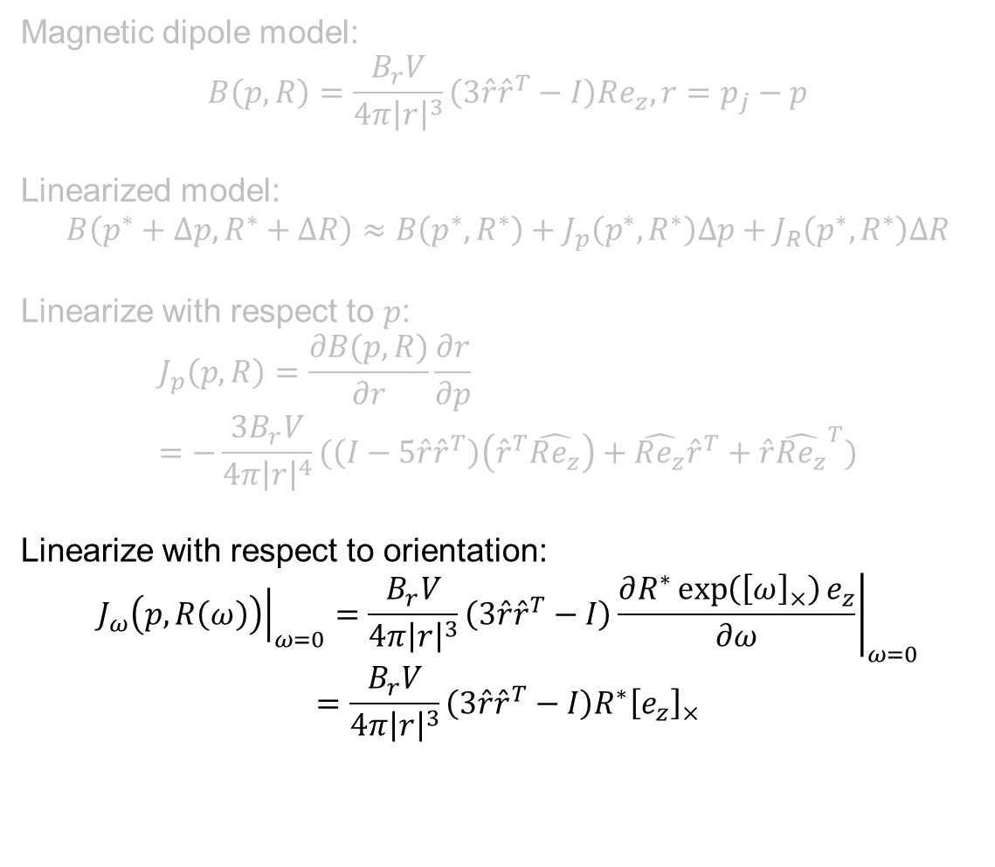
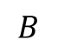
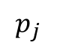
Magnetic dipole model and its linearization
Magnetic dipole model:
$$B\left(p, R\right)=\frac{B_{r}V}{4π{\left|r\right|}^{3}}\left(3\hat{r}{\hat{r}}^{T}−I\right)Re_{z}, r=p_{j}−p$$
Linearized model:
$$B\left(p^{∗}+Δp, R^{∗}+ΔR\right)≈B\left(p^{∗},R^{∗}\right)+J_{p}\left(p^{∗},R^{∗}\right)Δp+J_{R}\left(p^{∗},R^{∗}\right)ΔR$$
Linearize with respect to $p$:
$$J_{p}\left(p,R\right)=\frac{∂B(p,R)}{∂r}\frac{∂r}{∂p}=−\frac{3B_{r}V}{4π{\left|r\right|}^{4}}(\left(I−5\hat{r}{\hat{r}}^{T}\right)\left({\hat{r}}^{T}\hat{Re_{z}}\right)+\hat{Re_{z}}{\hat{r}}^{T}+\hat{r}{\hat{Re_{z}}}^{T})$$
Linearize with respect to orientation:
$${\left.J_{ω}\left(p,R\left(ω\right)\right)\right|}_{ω=0}=\frac{B_{r}V}{4π{\left|r\right|}^{3}}\left(3\hat{r}{\hat{r}}^{T}−I\right){\left.\frac{∂R^{∗}\exp\left({\left[ω\right]}_{×}\right)e_{z}}{∂ω}\right|}_{ω=0}$$
$$={\frac{B_{r}V}{4π{\left|r\right|}^{3}}\left(3\hat{r}{\hat{r}}^{T}−I\right)R}^{∗}{\left[e_{z}\right]}_{×}$$
$$p, R$$
$$B$$
$$p_{j}$$
Notes:
To compute the Jacobian at a certain rotation R_star, we simply rewrite the rotation matrix in the dipole model locally and take the partial derivative with respect to omega and evaluate it at 0. This local parametrization solves the null-space issue, allowing us to use the linearized model to analyze the local behavior of the magnetic dipole model.

Slide 11
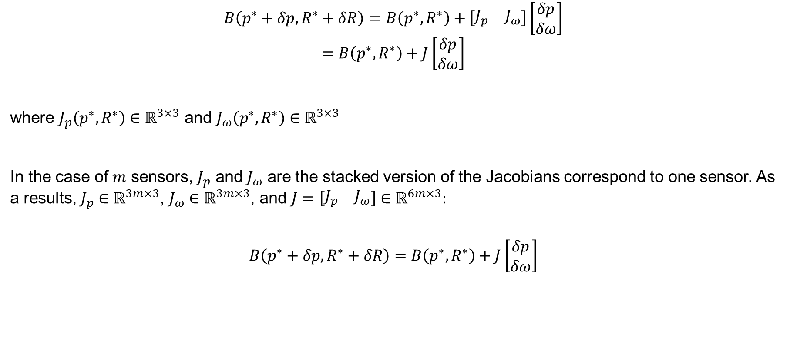
Linearized magnetic dipole model - Summary
$$B\left(p^{∗}+δp,R^{∗}+δR\right)=B\left(p^{∗},R^{∗}\right)+\left[\begin{matrix}J_{p} & J_{ω}\end{matrix}\right]\left[\begin{matrix}δp \\ δω\end{matrix}\right]$$
$$=B\left(p^{∗},R^{∗}\right)+J\left[\begin{matrix}δp \\ δω\end{matrix}\right]$$
where $J_{p}\left(p^{∗},R^{∗}\right)∈ℝ^{3×3}$ and $J_{ω}\left(p^{∗},R^{∗}\right)∈ℝ^{3×3}$
In the case of $m$ sensors, $J_{p}$ and $J_{ω}$ are the stacked version of the Jacobians correspond to one sensor. As a results, $J_{p}∈ℝ^{3m×3}$, $J_{ω}∈ℝ^{3m×3}$, and $J=\left[\begin{matrix}J_{p} & J_{ω}\end{matrix}\right]∈ℝ^{6m×3}:$
$$B\left(p^{∗}+δp,R^{∗}+δR\right)=B\left(p^{∗},R^{∗}\right)+J\left[\begin{matrix}δp \\ δω\end{matrix}\right]$$
Notes:
To summarize, we derive the linearized magnetic field model for one measured point, namely one sensor. In the case of multiple sensors, we can simply stack the equations and get the full expression.

Slide 12
Index
Motivation
Problem definition
Proposed approach
Magnetic field model
Gauss-Newton on manifold algorithm
Optimization of the sensor configuration
Experiments
Conclusion and outlooks
Notes:
With the linearized model derived, we can use it to develop the algorithm solves for the magnet’s configuration based on the magnetic field captured by the sensors.

Slide 13
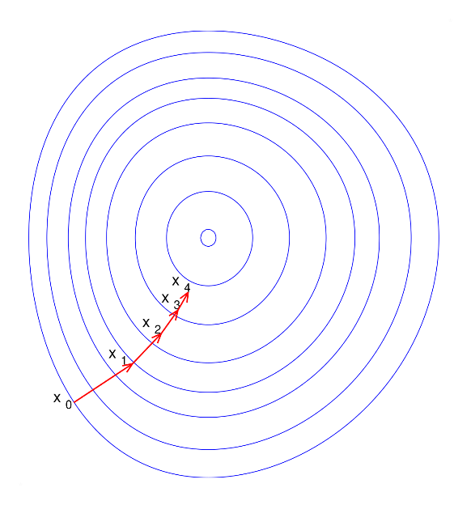
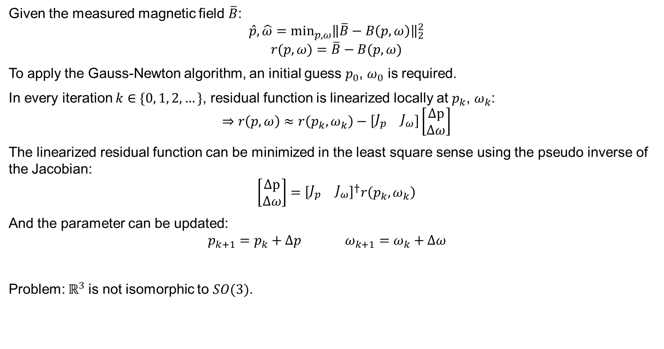
Classic Gauss-Newton algorithm
Given the measured magnetic field $\overline{B}$:
$$\hat{p}, \hat{ω}=\min_{p, ω}{\left\|\overline{B}−B\left(p,ω\right)\right\|}_{2}^{2}$$
$$r(p,ω)=\overline{B}−B(p,ω)$$
To apply the Gauss-Newton algorithm, an initial guess $p_{0}$, $ω_{0}$ is required.
In every iteration $k∈\{0, 1, 2,…\}$, residual function is linearized locally at $p_{k}$, $ω_{k}$:
$$⇒r\left(p,ω\right)≈r\left(p_{k},ω_{k}\right)−\left[\begin{matrix}J_{p} & J_{ω}\end{matrix}\right]\left[\begin{matrix}Δp \\ Δω\end{matrix}\right]$$
The linearized residual function can be minimized in the least square sense using the pseudo inverse of the Jacobian:
$$\left[\begin{matrix}Δp \\ Δω\end{matrix}\right]={\left[\begin{matrix}J_{p} & J_{ω}\end{matrix}\right]}^{†}r\left(p_{k},ω_{k}\right)$$
And the parameter can be updated:
$$p_{k+1}=p_{k}+Δp ω_{k+1}=ω_{k}+Δω$$
Problem: $ℝ^{3}$is not isomorphic to $SO(3)$.
Notes:
To solve for the magnet’s configuration give the measured magnetic field $\overline{B}$, we are effectively looking for the magnet’s configuration that minimizes the residual between the estimated magnetic field and the measurement in the least square sense. The classic Gauss-Newton method can be used to solve this minimization problem. To apply the Gauss-Newton method, we start with an initial guess p_0, w_0 and update the guess iteratively. In every iteration, the residual function is linearized at the current guess. As you may notice, B_bar in the residual function is just a constant vector. So the linearized residual function is nothing more than the negative of the linearized magnetic field model. This linearized problem can be solved by taking the pseudo inverse of the Jacobian and the update step is taken in the Euclidean space using simple summation.
The classic Gauss-Newton algorithm assumes the unknown parameter lies on some vector space isomorphic to the Euclidean space. It works naturally with the position. However, for orientation, which lies in SO(3), we can parametrize it in the Euclidean space using the exponential coordinate and apply this classic algorithm. However, as mentioned before, SO(3) is not isomorphic to R3, which will cause serious problem when applying these algorithms. Because the descent direction in R3 is not necessarily the descent direction in SO(3)

Slide 14
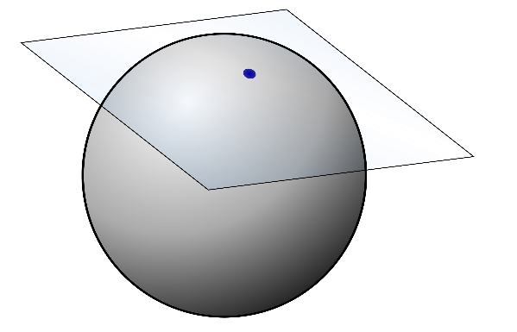
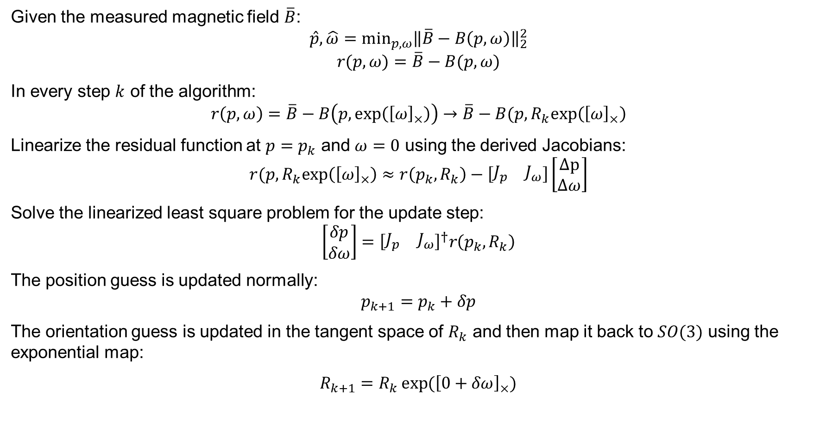
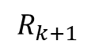
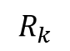
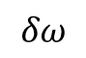
Gauss-Newton on manifold algorithm
Given the measured magnetic field $\overline{B}$:
$$\hat{p}, \hat{ω}=\min_{p, ω}{\left\|\overline{B}−B\left(p,ω\right)\right\|}_{2}^{2}$$
$$r(p,ω)=\overline{B}−B(p,ω)$$
In every step $k$ of the algorithm:
$$r\left(p,ω\right)=\overline{B}−B\left(p,exp\left({\left[ω\right]}_{×}\right)\right)→\overline{B}−B(p,R_{k}exp\left({\left[ω\right]}_{×}\right)$$
Linearize the residual function at $p=p_{k}$ and $ω=0$ using the derived Jacobians:
$$r(p,R_{k}exp\left({\left[ω\right]}_{×}\right)≈r\left(p_{k},R_{k}\right)−\left[\begin{matrix}J_{p} & J_{ω}\end{matrix}\right]\left[\begin{matrix}Δp \\ Δω\end{matrix}\right]$$
Solve the linearized least square problem for the update step:
$$\left[\begin{matrix}δp \\ δω\end{matrix}\right]={\left[\begin{matrix}J_{p} & J_{ω}\end{matrix}\right]}^{†}r\left(p_{k},R_{k}\right)$$
The position guess is updated normally:
$$p_{k+1}=p_{k}+δp$$
The orientation guess is updated in the tangent space of $R_{k}$ and then map it back to $SO(3)$ using the exponential map:
$R_{k+1}=R_{k}\exp{({\left[0+δω\right]}_{×})}$
$$δω$$
$$R_{k}$$
$$R_{k+1}$$
Notes:
To solve for the magnet’s configuration given the measured magnetic field $\overline{B}$, we are effectively looking for the magnet’s configuration that minimizes the residual between the estimated magnetic field and the measurement in the least square sense. The classic Gauss-Newton algorithm can be used if the unknown parameters are in the Euclidean space. It just start with an initial guess and update the guess iteratively, in the Euclidean space. Even though we can parametrize the orientation in Euclidean space, it’s not isomorphic to the orientation space. It will cause serious problem using this gradient-based method. Because the descent direction in the Euclidean space is not necessarily the descent direction in SO(3).
To solve this issue, we need to adapt the algorithm using local parametrization. That is, in every step k of the algorithm, rewrite the residual function using the local parametrization of rotation. The residual function is linearized with respect to the p and omega respectively, but make sure to evaluate the Jacobian at omega=0. As you may notice, B_bar in the residual function is just a constant vector. So the linearized residual function is nothing more than the negative of the linearized magnetic field model. This linearized problem can be solved by taking the pseudo inverse of the Jacobian, where we obtain the update step. The position is updated using summation, while for the orientation, it’s updated in the tangent space of R_k and mapped back to the group of SO(3) using the exponential map. The summation in SO(3) becomes multiplication.

Slide 15
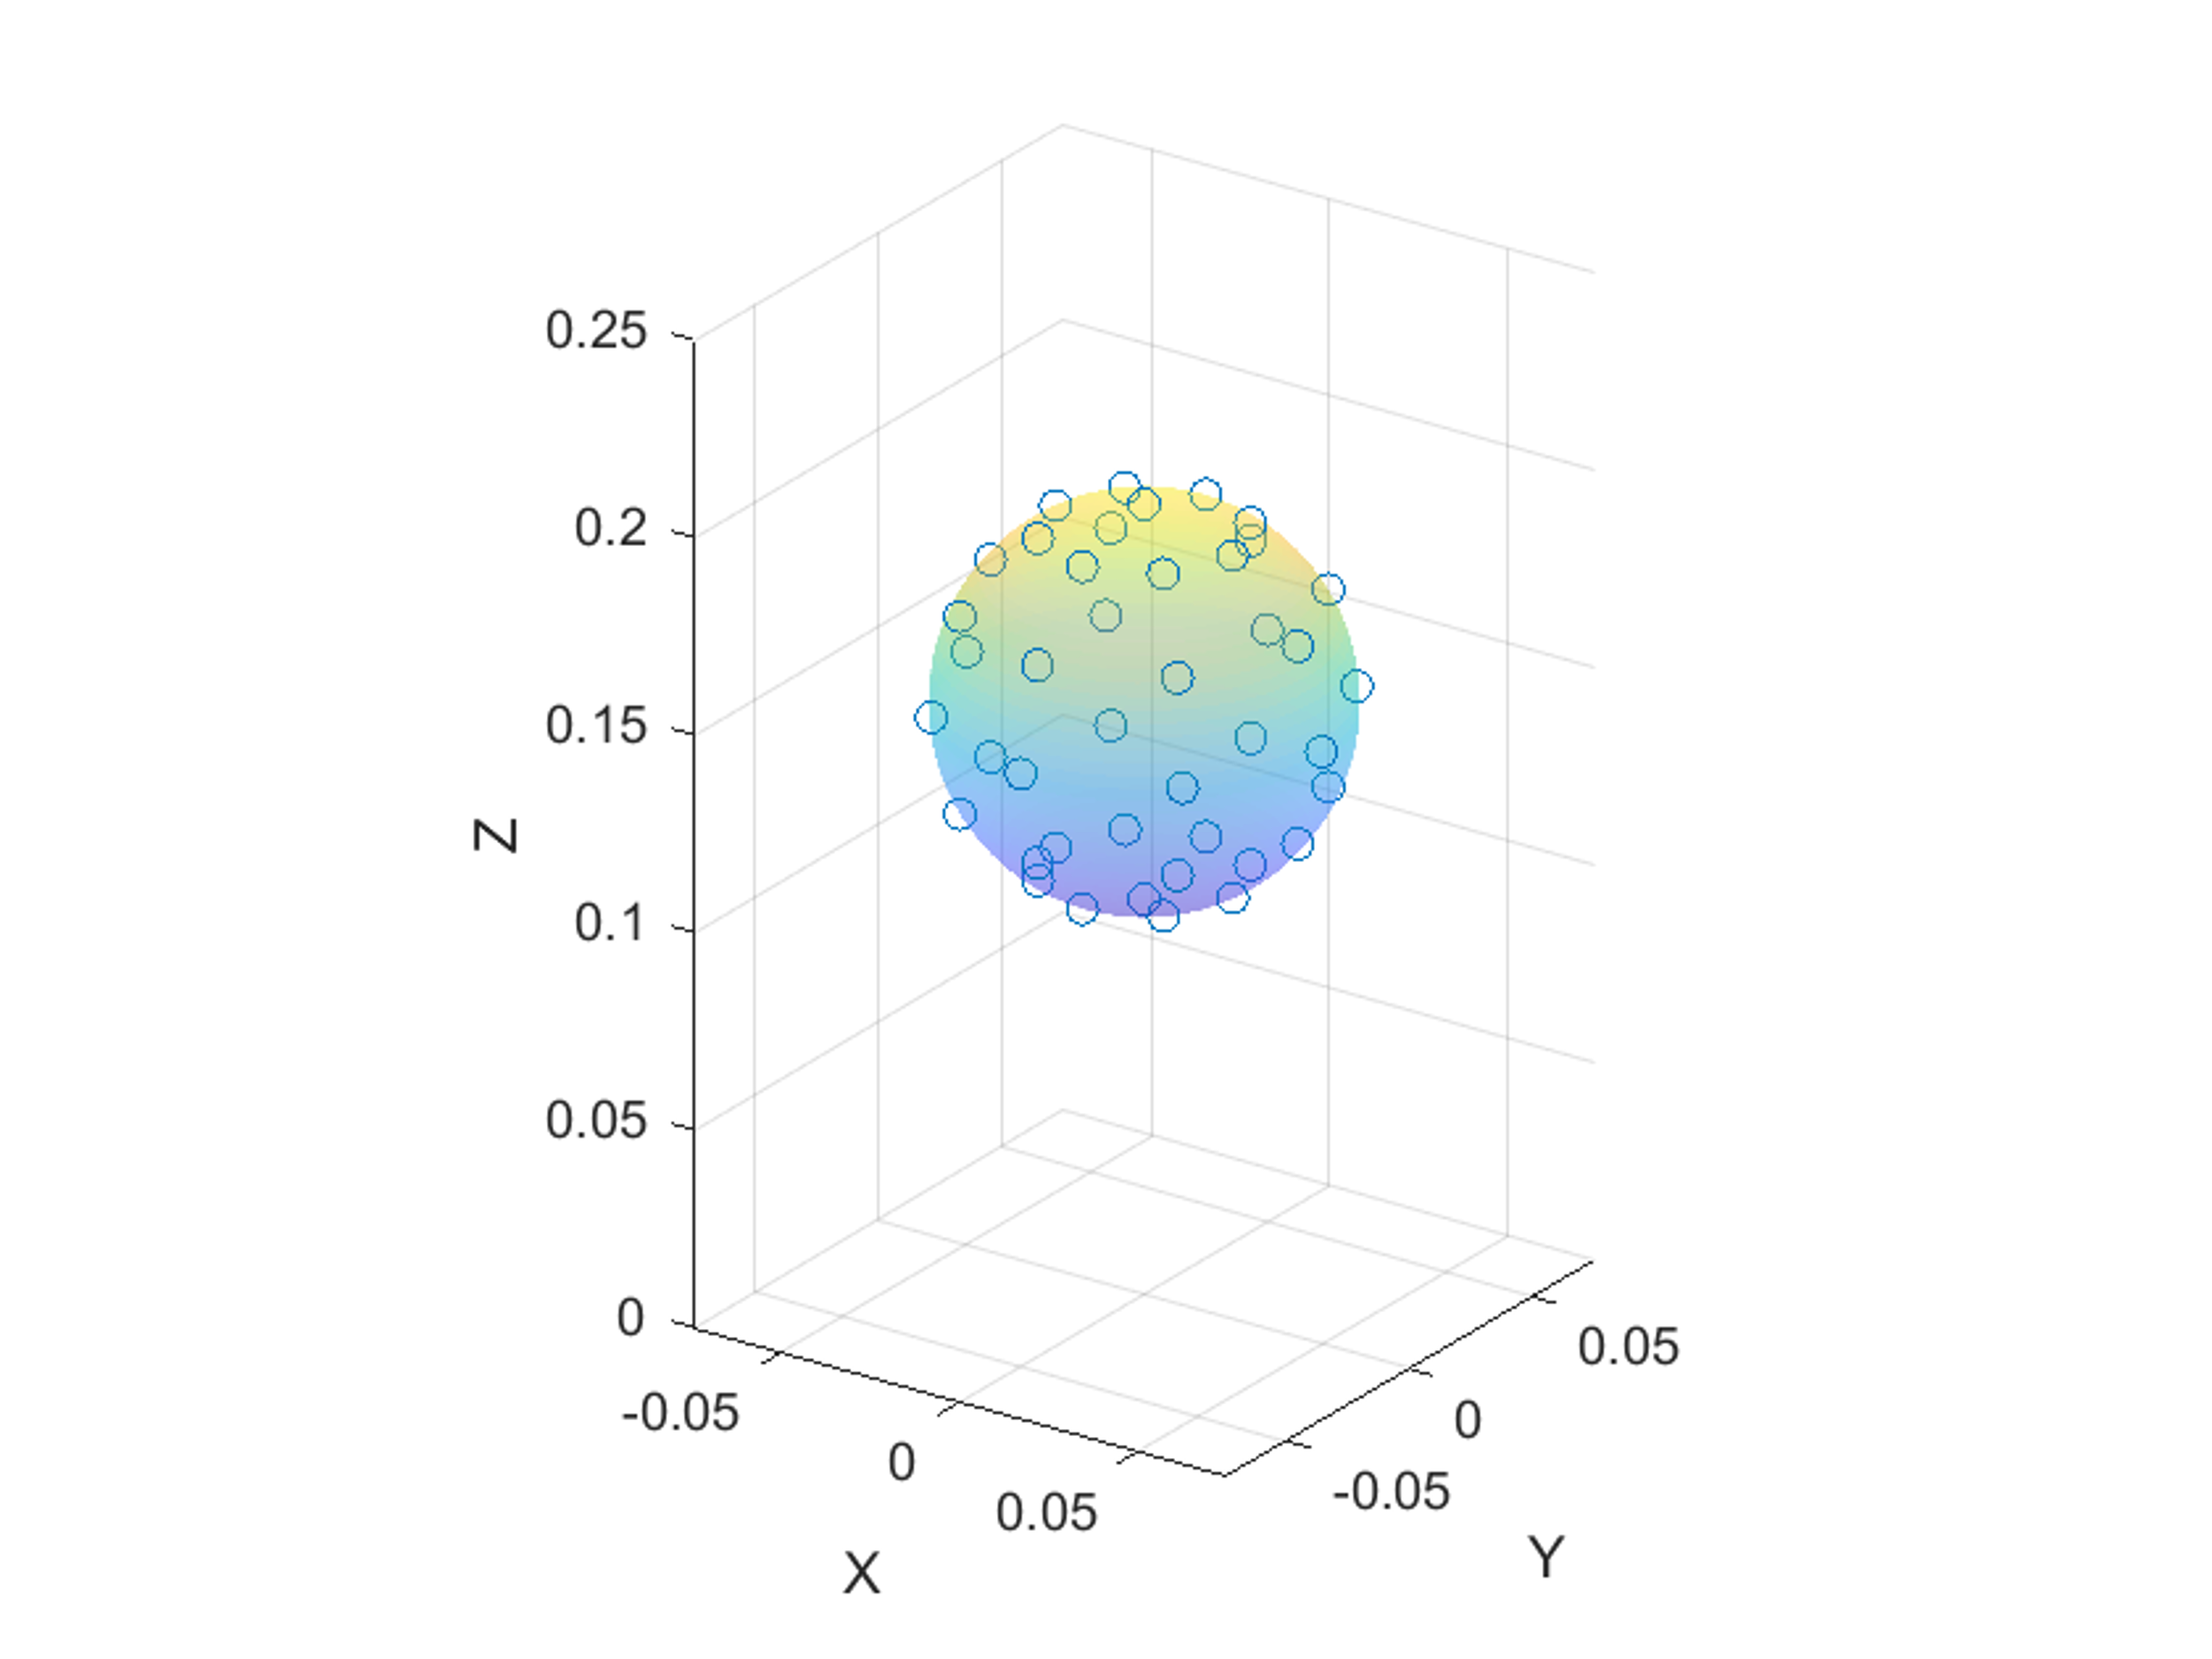
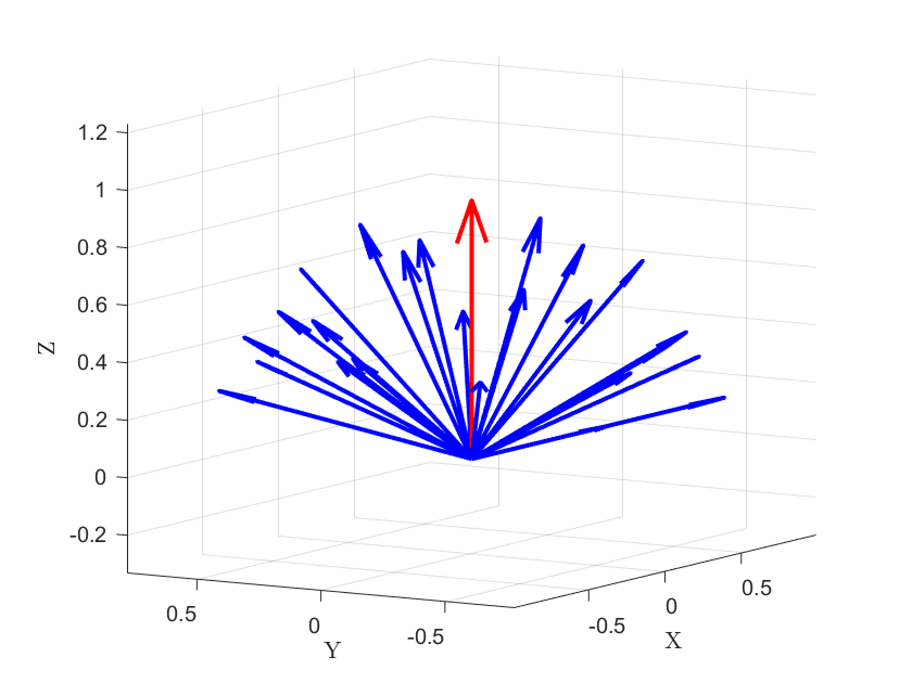
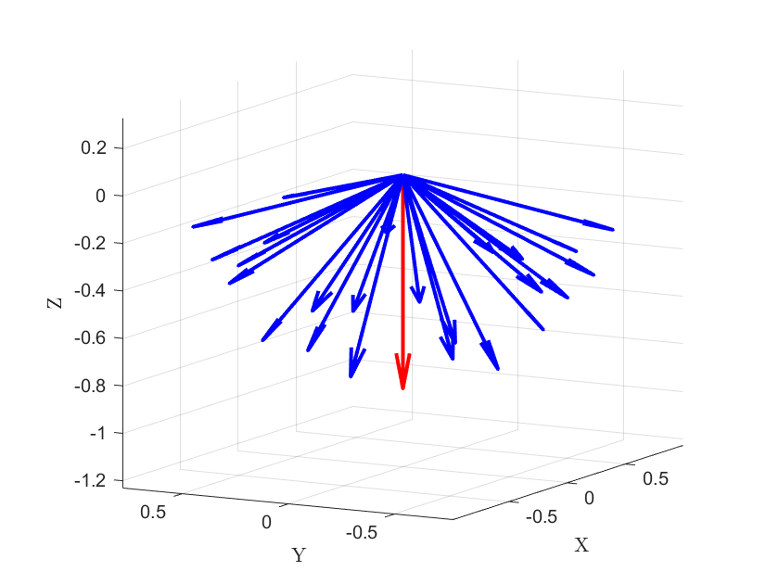
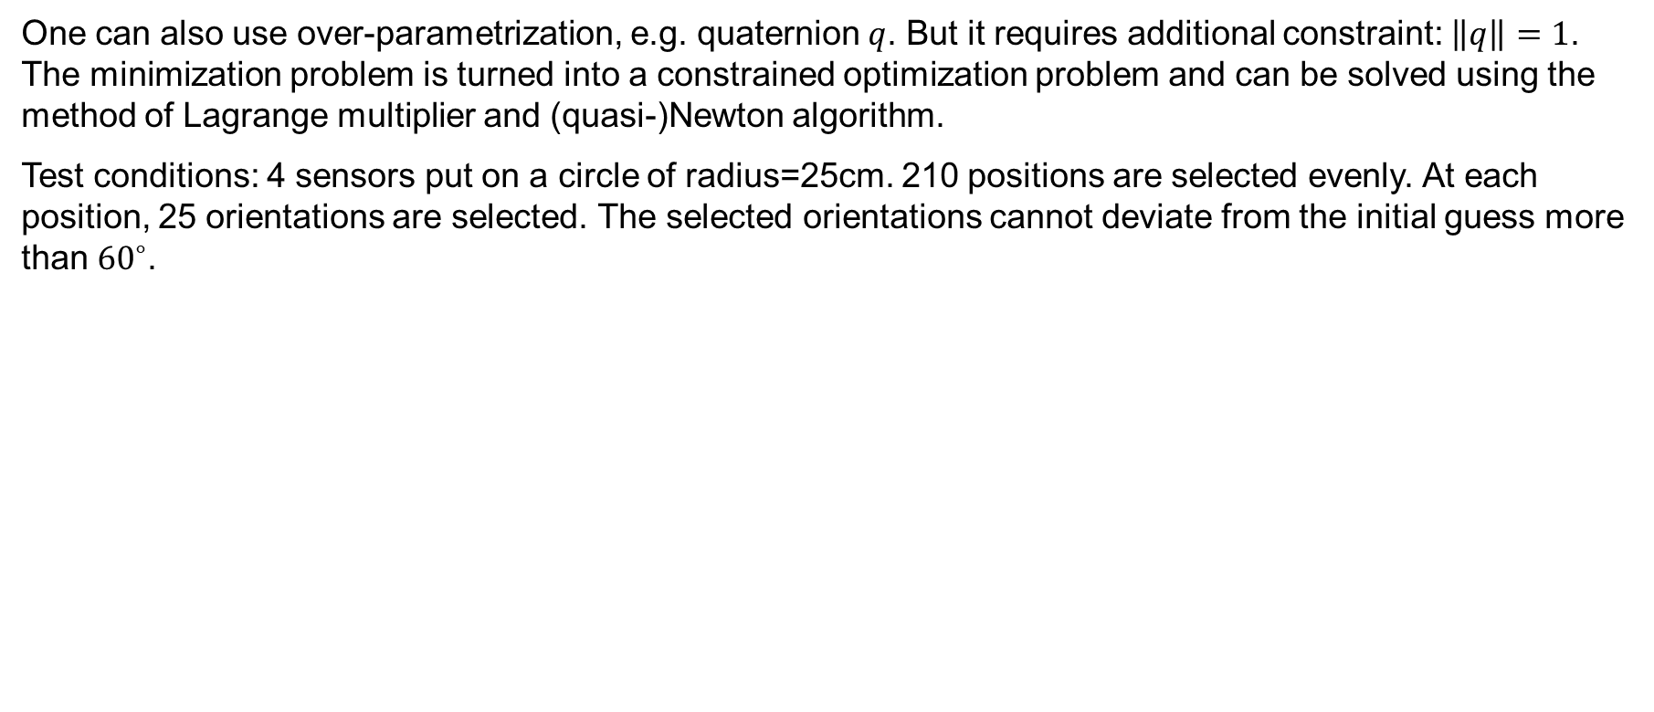
Comparison with MATLAB’s algorithm
One can also use over-parametrization, e.g. quaternion $q$. But it requires additional constraint: $\left\|q\right\|=1$. The minimization problem is turned into a constrained optimization problem and can be solved using the method of Lagrange multiplier and (quasi-)Newton algorithm.
Test conditions: 4 sensors put on a circle of radius=25cm. 210 positions are selected evenly. At each position, 25 orientations are selected. The selected orientations cannot deviate from the initial guess more than ${60}^{∘}$.
42 positions on one sphere radius
25 orientations selected at each position
Different cone orientations
Notes:
One can also use over-parametrization to solve the singularity issue, such as the quaternion. But it requires additional constraint and it turns the minimization problem to a constrained problem, which still can be solved using the method of Lagrange multiplier and quasi-Newton method. This algorithm is implemented in MATLAB and we compare the Gauss-Newton algorithm to MATLAB’s one.
We simulated 4 sensors on a circle of radius 25cm. And we need to sample the magnet configuration to be solved. Within the spherical workspace, 5 different radii are sampled and on each sphere, 42 positions are selected evenly. In terms of orientation, since both algorithms converge locally, we limit the orientation to be within 60 deg from the initial guess, which is like a cone of different orientations and the initial guess is the center vector. Each cone has 25 orientations. To cover the whole workspace, 16 different orientations of the cone are considered, but the initial guess for the orientation is always the center of the cone. Making it in total 84000 test configurations. The initial guess for the position is chosen to be the center of the sphere.

Slide 16
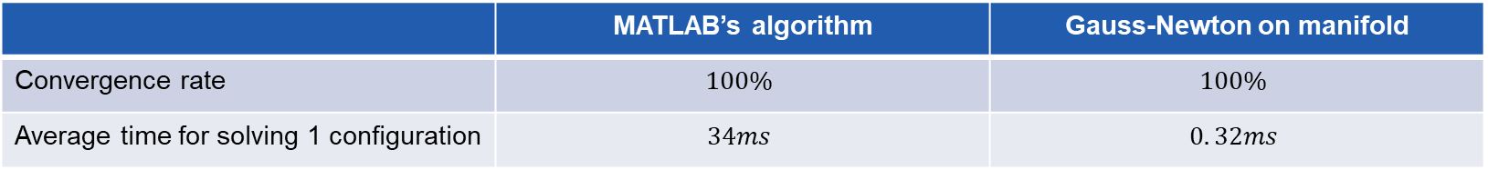
Comparison with MATLAB’s algorithm
 | MATLAB’s algorithm | Gauss-Newton on manifold
Convergence rate | $$100\%$$ | $$100\%$$
Average time for solving 1 configuration | $$34ms$$ | $$0. 32ms$$
The Gauss-Newton on manifold algorithm is ~100 times faster than the MATLAB’s algorithm.
Notes:
First we test if the algorithm converges to the solution for all the configurations. We observe that both algorithms converge 100% for all the 84000 configurations. In terms of the convergence speed, we witness that the Gauss-Newton algorithm is about 100 times faster than the MATLAB’s algorithm, which is beneficial for real-time application.

Slide 17
Index
Motivation
Problem definition
Proposed approach
Magnetic field model
Gauss-Newton on manifold algorithm
Optimization of the sensor configuration
Experiments
Conclusion and outlooks
Notes:
With the algorithm developed, we aim to optimize the sensor configuration such that the algorithm works better, in terms of the accuracy and speed.

Slide 18
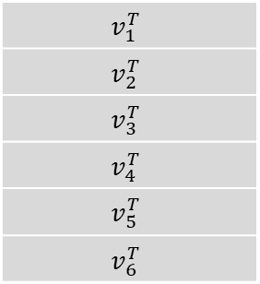
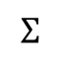
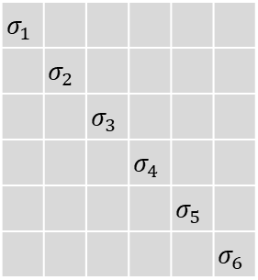
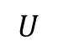
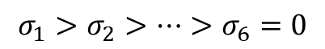
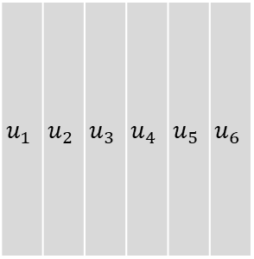
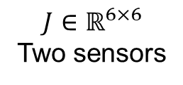






Optimization criteria - Minimum singular value $σ_{min}$
The linear model at certain configuration $p^{∗},R^{∗}$: $ΔB=JΔx$
Singular value decomposition of $J∈ℝ^{3m×6}$:
$$J=UΣV^{T}$$
$$u_{1}$$ | $$u_{2}$$ | $$u_{3}$$ | $$u_{4}$$ | $$u_{5}$$ | $$u_{6}$$
$$σ_{1}$$
 | $$σ_{2}$$
 |  | $$σ_{3}$$
 |  |  | $$σ_{4}$$
 |  |  |  | $$σ_{5}$$
 |  |  |  |  | $$σ_{6}$$
$$v_{1}^{T}$$
$$v_{2}^{T}$$
$$v_{3}^{T}$$
$$v_{4}^{T}$$
$$v_{5}^{T}$$
$$v_{6}^{T}$$
$$=$$
$$∗$$
$$∗$$
$$J∈ℝ^{6×6}$$
Two sensors
$$U$$
$$Σ$$
$$V^{T}$$
$$σ_{1}>σ_{2}>…>σ_{6}=0$$
$$σ_{min}≜σ_{5}$$
$$v_{min}≜v_{5}$$
$$USV^{T}∗v_{5}=σ_{5}v_{5}$$
Notes:
We first need to define the optimization criteria. One of the reasons we develop the linear model is it allows us to analyze how the magnetic field behaves when the magnet move around a certain configuration. The linear model relates the change in magnet configuration to the change in the magnetic field using the Jacobian. By analyzing the property of the Jacobian, we can estimate what the change in the magnet configuration affects the change in the magnetic field. To achieve this purpose, we take the singular value decomposition of the Jacobian J, which factorize the matrix into 3 parts, an orthogonal matrix U, a diagonal matrix Sigma, and another orthogonal matrix V. The diagonal elements of Sigma are the singular values of J. They are ordered in descending order. And the number of non-zero singular values equal to the rank of the Jacobian. In the case of a 5DOF system, as we have, sigma_6 = 0 and its corresponding right singular vector v_6 represents the motion that doesn’t change the magnetic field. You will find this motion is the z-axis rotation and this DOF is not observable. We are interested in the observable DOF that we want to solve and how those motion change the magnetic field. In particular, we are interested in the one that generates the minimum change of magnetic field. This information is captured by minimum non-zero singular value sigma_5 and its singular vector v_5, which I will call them sigma_min and v_min from now on. The motion in the direction of v_min will be scaled down the most by the minimum singular value. When there is noise in the measurement, we wouldn’t know what causes the change in the magnetic field. Is it the noise or the motion in v_min. It leads to our first hypothesis:

Slide 19








Optimization criteria - Minimum singular value $σ_{min}$
Hypothesis 1: For the Jacobian of a certain configuration, $v_{min}$ represents the motion direction that‘s hardest to distinguish from noise. When the algorithm tries to solve the magnet‘s configuration, this direction is the hardest to resolve from noise. As a result, it contributes the most to the error.
Hypothesis 2: If $σ_{min}$ is larger, the same amount of motion in the direction of $v_{min}$ generates larger $\left|\left|ΔB\right|\right|$. As a result, when the algorithm tries to solve for the magnet‘s configuration, the error is smaller.
Criterion 1: Maximize ${mean}_{x∈𝒳}σ_{min}(x)$
$$v_{5}$$
$$<e,v_{5}>$$
$$e$$
$$<e,v_{3}>$$
$$v_{3}$$
$$<e,v_{4}>$$
$$v_{4}$$
Notes:
It leads to our first hypothesis: when the algorithm tries to solve the magnet configuration from the noisy measurement, it will make the most error in the direction of v_min, which can be verified if we project the error vector on the each of the singular vectors and check the norm of the projected vector. The second hypothesis naturally follows, if the \sigma_min is larger, the same amount of motion in the least solvable direction, v_min, will generates a bigger change in the magnetic field, making it more robust to noise. As a result, the estimation will be closer to the ground truth and the error will be smaller. Based on these hypothesis, the first criteria is the minimum singular value, we want to maximize it in the entire workspace such that we have higher accuracy in estimating the configuration. It can be represented by the average value of the sigma_min.

Slide 20


Optimization criteria – Condition number $κ$
Condition number: $κ=\frac{σ_{max}}{σ_{min}}∈[1, +∞]$
Every step in the Gauss-Newton algorithm requires taking the pseudo-inverse of the Jacobian:
$$\left[\begin{matrix}Δp \\ Δω\end{matrix}\right]=Δx={J(p_{k},R_{k})}^{†}r$$
There might be error in evaluating $J$ and $r$, $δJ$ and $δr$, resulting in the error computing $Δx$, $δx$:
$$Δx+δx={\left(J+δJ\right)}^{†}(r+δr)$$
$δJ$ and $δr$ can come from numerical rounding, noise, etc.
Wedin, 1973, provides an upper bound on $δx$using the condition number $κ$under some assumptions:
$J$ and $J+δJ$ have equal rank
${\left\|δJ\right\|}_{2}<ε{\left\|A\right\|}_{2}$
$εκ<1$
Notes:
Another possible criteria is the condition number, which is the ratio between the maximum singular value and the minimum one. As we’ve seen, in every step of the Gauss-Newton algorithm, the pseudo inverse of the Jacobian is taken and this step is prone to error. For example, the error can come from J and r, which will lead to the error when we compute the update steps. Researchers have established the relationship between the upper bound of this error and the error in J and r using the condition number. We can observe that when the condition number is lower, the error in computing the pseudo inverse is lower.

Slide 21

Optimization criteria – Condition number $κ$
Hypothesis 3: The smaller $κ$ for all the configuration, the less error in calculating the update step. The faster convergence for the algorithm.
Criterion 2: Maximize $\min_{x∈𝒳}\frac{1}{κ}(x)$
Notes:
And it leads to our third hypothesis. If the condition number is smaller in the workspace, the algorithm will converge faster. So, we want to minimize the condition number or, to align with our previous criteria, we can maximize the reciprocal condition number, which can be achieved by maximizing the minimum of the reciprocal condition number in the workspace.

Slide 22


Optimized configuration
29 positions selected on the surface of the spherical workspace
17 orientations selected on each position
493 configurations are considered for optimization
Notes:
Now we have derived the criteria for optimization. We need to sample the workspace where we evaluate the two criteria and optimize the sensor configuration for them. 29 positions are sampled from the surface of the sphere. At each position, 17 orientations are chosen. We only chose the orientation facing up because we found that the singular values for two configurations at the same position but facing the opposite directions are exactly the same. So we don’t need to optimize them repeatedly.

Slide 23


Optimization using the multi-objective genetic algorithm
Genetic algorithm: An algorithm tries to find the optimum of the objective(s) based on the natural selection process that mimics biological evolution.
The Pareto front: The candidates on the Pareto front is strictly dominating other candidates for at least one criteria.
The optimization is run for different number of sensors $m∈\{4, 5, 9, 16\}$.
Notes:
To perform the optimization, we use the genetic algorithm toolbox provided by MATLAB. It tries to find the optimum of the objectives mimicing biological evolution. It is often easier to find the global optimum but requires large computation time. Because we are doing a multi-objective optimization, the result is given by the Pareto front. Here is an example of the Pareto front of a 2-objective optimization, just like what we are doing. The red dots are on the Pareto front because we can see there is no other candidate that is better than the red ones in both objectives. The Pareto front gives us the best trade-off available for two competing objectives. With the basics understood, we run the optimization for different numbers of sensors and let’s check the results.

Slide 24




Optimization results – 4 sensors
Notes:
This is the Pareto front obtained for 4 sensors. We get a similar pattern as shown before, indicating the two criteria are competing. Take a closer look, we check the sensor configuration for three candidates on the Pareto front and observe that they are more or less equidistant away from the magnet‘s workspace. Moving from left to right on the Pareto front only makes this distance larger.

Slide 25




Optimization results – 5 sensors
Notes:
We observe similar phenomenon for the 5 sensors results.

Slide 26




Optimization results – 9 sensors
Notes:
The nine sensors results.

Slide 27




Optimization results – 16 sensors
Notes:
And the 16 sensors results. The algorithm seems to try to put the sensors on a circle of different radii.

Slide 28




Circular configuration as the optimum
4 sensors
5 sensors
9 sensors
16 sensors
Notes:
Following this observation, we generate a „manual“ Pareto front by putting the sensors on a circle and vary the radius from 1 centimeter to 1 meter. We record the trend of the two criteria and compare it to the Pareto front obtained by the genetic algorithm. We surprisingly found that the manual Pareto front obtained from the circular configuration coincides with the one from genetic algorithm, with some candidates even better than the genetic algorithm. We conclude that the circular configuration is the optimal solution for maximizing both criteria.

Slide 29

Summary
Defined the optimization criteria
${mean}_{x∈𝒳}σ_{min}(x)$: accuracy
$\min_{x∈𝒳}\frac{1}{κ}\left(x\right)$: speed
Sensor optimization: Circular configuration is the one that optimizes both criteria.
Notes:
To summarize, in this section, we defined the two optimization criteria, the minimum singular value that affects the convergence accuracy and the reciprocal condition number affects the convergence speed. Optimizing these criteria, we obtain a circular configuration.

Slide 30
Index
Motivation
Problem definition
Proposed approach
Magnetic field model
Gauss-Newton on manifold algorithm
Optimization of the sensor configuration
Experiments
Conclusion and outlooks
Notes:
To compare the performance of different sensor configuration different level of the objectives, we conducted experiments, both in simulation or physically, trying to verify the hypothesis.

Slide 31





Simulated convergence test with noise for $σ_{min}$ – settings
4 sensors put on a circle of different radii, $r=\left\{5, 10, 20, 30\right\}cm$.
$$r=10cm$$
$$r=5cm$$
$$r=20cm$$
$$r=30cm$$
Notes:
We first tried to test the two hypothesis regarding the minimum singular value: the sensor configuration with higher average singular value has less error in estimating the magnet’s configuration. The error in estimation mostly lies in the direction of v_min.
We first did this experiment in simulation, where 4 sensors are put on a circle with 4 different radii. They have different level of average minimum singular values.

Slide 32


Simulated convergence test with noise for $σ_{min}$ – settings
6760 configurations are considered: 210 positions, 32 orientations at each positions.
Simulated magnetic field measurement is computed from the dipole model.
Different levels of Gaussian noise are added to the measurements. $σ^{2}=\left\{0.05, 0.1, 0.5\right\}μT$.
To ensure convergence and only compare the error after convergence, the initial guess of the algorithm is the ground truth configuration, which is close enough to the solution.
42 positions on one sphere radius, 5 radii are considered
32 orientations are sampled at one position
Notes:
Within the magnet workspace, more than 6000 configurations are sampled. The ground truth magnetic field captured by the sensors are modelled using the dipole model. And they are corrupted by different level of Gaussian noise, which is represented by the variance of the Gaussian distribution. The level of 0.05uT noise is the one we measured in the physical sensors we will use later for physical experiment. Because the algorithm works locally, to ensure convergence and only compare the accuracy, we start the initial guess at the ground truth configuration, which is close enough to the solution and when we run the algorithm, it will deviate from it because of noise, resulting in estimation error.

Slide 33










Simulated convergence test with noise for $σ_{min}$ – settings
The position error $e_{p}$ is the discrepency between the ground truth postion and the solution given by the algorithm, measured in mm. The orientation is the discrepency between the ground truth z-axis and the z-axis after convergence, measured in deg.
The error vector is projected on the 5 singular vectors to examine the hypothesis.
$$e_{R}$$
$$\hat{p}, \hat{R}$$
$$p^{∗}, R^{∗}$$
$$e_{p}$$
$$v_{5}$$
$$<e,v_{5}>$$
$$e$$
$$<e,v_{3}>$$
$$v_{3}$$
$$<e,v_{4}>$$
$$v_{4}$$
Notes:
Here is an example of how the error is calculated. The red arrow represents the ground truth configuration and the blue one is the estimation. The position error is the distance between the estimation and the ground truth, the orientation error is the angle of these two vectors. The position errors are measured in millimeter and the orientation error is measured in deg. To test the hypothesis that the error comes mostly from the v_min direction, we project the error vector onto the 5 non-zero singular vectors and compare their norm.

Slide 34







Simulated convergence test with noise for $σ_{min}$ – results
$$e_{R}$$
$$\hat{p}, \hat{R}$$
$$p^{∗}, R^{∗}$$
$$e_{p}$$
Noise:$0.05μT$ | $$r=5cm$$ | $$r=10cm$$ | $$r=20cm$$ | $$r=30cm$$
$$mean(σ_{min})$$ | $$1.03e−5$$ | $$1.12e−5$$ | $$4.07e−6$$ | $$1.65e−6$$
$${mean(e}_{p}) (mm)$$ | $$0.63$$ | $$0.57$$ | $$1.40$$ | $$4.17$$
$${mean(e}_{R}) (deg)$$ | $$0.37$$ | $$0.31$$ | $$0.57$$ | $$1.28$$
Noise:$0.1μT$ | $$r=5cm$$ | $$r=10cm$$ | $$r=20cm$$ | $$r=30cm$$
$$mean(σ_{min})$$ | $$1.03e−5$$ | $$1.12e−5$$ | $$4.07e−6$$ | $$1.65e−6$$
$${mean(e}_{p}) (mm)$$ | $$1.27$$ | $$1.14$$ | $$2.79$$ | $$8.63$$
$${mean(e}_{R}) (deg)$$ | $$0.74$$ | $$0.62$$ | $$1.14$$ | $$2.55$$
Noise:$0.5μT$ | $$r=5cm$$ | $$r=10cm$$ | $$r=20cm$$ | $$r=30cm$$
$$mean(σ_{min})$$ | $$1.03e−5$$ | $$1.12e−5$$ | $$4.07e−6$$ | $$1.65e−6$$
$${mean(e}_{p}) (mm)$$ | $$6.37$$ | $$5.71$$ | $$14.20$$ | $$46.11$$
$${mean(e}_{R}) (deg)$$ | $$3.68$$ | $$3.12$$ | $$5.80$$ | $$13.8$$
Notes:
We first look at the result of the 0.05uT noise level. We can observe that the configuration with the largest average sigma-min, which is 10cm configuration, have smallest error, in both position and orientation. And the amount of error can actually be ranked according to the level of average sigma-min. This phenomenon is the same for the other two higher level of noise. It verifies our hypothesis that the sensor configuration with larger minimum singular value is more robust to noise.

Slide 35
Simulated convergence test with noise for $σ_{min}$ – results
Noise:$0.05μT$ $$r=0.05m$$ | $$\frac{|<e,v_{1}>|}{|e|}$$ | $$\frac{|<e,v_{2}>|}{|e|}$$ | $$\frac{|<e,v_{3}>|}{|e|}$$ | $$\frac{|<e,v_{4}>|}{|e|}$$ | $$\frac{|<e,v_{min}>|}{|e|}$$
Ratio | $$18\%$$ | $$14\%$$ | $$30\%$$ | $$50\%$$ | $$60\%$$
Noise:$0.05μT$ $$r=0.10m$$ | $$\frac{|<e,v_{1}>|}{|e|}$$ | $$\frac{|<e,v_{2}>|}{|e|}$$ | $$\frac{|<e,v_{3}>|}{|e|}$$ | $$\frac{|<e,v_{4}>|}{|e|}$$ | $$\frac{|<e,v_{min}>|}{|e|}$$
Ratio | $$22\%$$ | $$19\%$$ | $$35\%$$ | $$48\%$$ | $$53\%$$
Noise:$0.05μT$ $$r=0.20m$$ | $$\frac{|<e,v_{1}>|}{|e|}$$ | $$\frac{|<e,v_{2}>|}{|e|}$$ | $$\frac{|<e,v_{3}>|}{|e|}$$ | $$\frac{|<e,v_{4}>|}{|e|}$$ | $$\frac{|<e,v_{min}>|}{|e|}$$
Ratio | $$30\%$$ | $$35\%$$ | $$34\%$$ | $$43\%$$ | $$45\%$$
Noise:$0.05μT$ $$r=0.30m$$ | $$\frac{|<e,v_{1}>|}{|e|}$$ | $$\frac{|<e,v_{2}>|}{|e|}$$ | $$\frac{|<e,v_{3}>|}{|e|}$$ | $$\frac{|<e,v_{4}>|}{|e|}$$ | $$\frac{|<e,v_{min}>|}{|e|}$$
Ratio | $$36\%$$ | $$38\%$$ | $$35\%$$ | $$38\%$$ | $$42\%$$
Notes:
To show our other hypothesis that the error mostly comes from the direction that is the hardest to distinguish from noise, i.e. the direction specified by v_min. We project the error vector onto the 5 singular vectors respectively and checked how much error each direction contributes. We first look at the 5cm configuration with 0,05uT noise, the error projected on the v-min has 60% of the norm of the error vector, which is the largest. And it’s 50% for the projection on v_4, which is the second hardest direction to distinguish from noise. The same phenomenon can be observed from other sensor configurations. It verifies our hypothesis that: the error comes mostly from the direction of v-min.

Slide 36






Noise-free simulated convergence test for $\frac{1}{κ}$ – settings
4 sensors put on a circle of different radii, $r=\left\{0.05, 0.1, 0.2, 0.3, 1\right\}m$.
$$r=0.1m$$
$$r=0.05m$$
$$r=0.2m$$
$$r=1m$$
$$r=0.3m$$
Notes:
We also examine the hypothesis for reciprocal condition number, which is: the sensor configuration that has higher level of condition converges faster to the solution. We selected 5 different configurations with different level of condition number.

Slide 37

Noise-free simulated convergence test for $\frac{1}{κ}$ – settings
5250 configurations are considered: 210 positions, 25 orientations at each positions.
Simulated magnetic field measurement is computed from the dipole model. No noise is added to the measurement.
The initial guess for the position is the center of the sphere; The initial guess for the orientation is the center vector of the cone.
We first examine if the convergence range is affected by $\min_{x∈𝒳}\frac{1}{κ}\left(x\right)$. Then the cone size is fixed. The convergence speed is tested to examine if the convergence speed is affected by $\min_{x∈𝒳}\frac{1}{κ}\left(x\right)$.
42 positions on one sphere radius, 5 radii are considered
25 orientations are sampled at one position
Notes:
To test this hypothesis properly, we need to start the initial guess away from the ground truth. The cone like test configuration is used again. 210 positions are sampled and a cone of 25 different orientations are considered. The initial guess for the position is the center of the workspace, while the initial guess for the orientation aligns with the center vector of the cone. We first test if the convergence range is affected by the condition number, which is measured by how big of the cone is while the algorithm still converge to the ground truth 100%. Is it 30 deg, 45 deg? We will see. Then we fix the cone size that all the test configurations converge and test the convergence speed.

Slide 38







Noise-free simulated convergence test for $\frac{1}{κ}$ – results
 | $$r=0.05m$$ | $$r=0.1m$$ | $$r=0.2m$$ | $$r=0.3m$$ | $$r=1m$$
$$\min{\frac{1}{κ}}$$ | $$0.05$$ | $$0.10$$ | $$0.18$$ | $$0.23$$ | $$0.13$$
Cone size | $$5^{∘}$$ | $${12.5}^{∘}$$ | $${55}^{∘}$$ | $${75}^{∘}$$ | $${120}^{∘}$$
Cone size $={12.5}^{∘}$ | $$r=0.1m$$ | $$r=0.2m$$ | $$r=0.3m$$ | $$r=1m$$
$$\min{\frac{1}{κ}}$$ | $$0.10$$ | $$0.18$$ | $$0.23$$ | $$0.13$$
Average time for solving one test set of 5250 configurations | $1.72$s | $1.49$s | $1.37$s | $1.22$s
Notes:
For the convergence range test, we can see that it increases monotonically as the size of the circle increases, and it is the biggest for the radius of 1m, even though the condition number is low. It means that the condition number is not an indicator of how globally the algorithm can converge. We then fix the cone size to 12.5 deg and test if the condition number affect the convergence speed. We also witness a similar phenomenon that the larger the circle is, the faster the algorithm converges. This disprove our hypothesis. A possible reason is that when the algorithm is updating the guess, the updated guess goes out of the spherical workspace that has been optimized for. The reciprocal condition number can be very low in those configurations, indicating that the Jacobian is ill-conditioned. As a result, taking the pseudo-inverse of that Jacobian may gives a very big step for the update, causing the algorithm to diverge. However, putting the sensor far away from the magnet's workspace makes the reciprocal condition number stable for a larger area. Even though one update step might result in a guess that is out of the optimized spherical workspace, the Jacobian is well-conditioned enough for the algorithm to converge back to the solution. Further investigation is required to understand this phenomenon.

Slide 39










Physical experiments for $σ_{min}$– settings
4 PNI RM3100 sensors are put on a circle of two radii, $r=\left\{5, 10\right\}cm$.
7 positions are sampled in the spherical workspace, 32 orientations are sampled at each position. The magnetic field is recorded for each configuration.
$$p=\left[\begin{matrix}0 \\ 0 \\ 0.20\end{matrix}\right]$$
$$p=\left[\begin{matrix}0 \\ 0.05 \\ 0.15\end{matrix}\right]$$
$$p=\left[\begin{matrix}0 \\ −0.05 \\ 0.15\end{matrix}\right]$$
$$y$$
$$x$$
$$p=\left[\begin{matrix}0 \\ 0 \\ 0.1\end{matrix}\right]$$
$$z$$
Notes:
We also conducted physical experiments to further confirm that our hypothesis on sigma_min is true. We used 4 PNI sensors and considered 2 scenarios, where the sensors are put on the circle with radius 5cm or 10cm. Here is an example of a 5cm circle. Seven positions are sampled in the spherical workspace: top and bottom, four on the side and one at the center. At each position, 32 orientations are sampled, resulting in totally 224 test configurations.

Slide 40






Physical experiments for $σ_{min}$ – settings
The sensor positions are calibrated using the recorded field.
For each test configuration, the algorithm starts at the ground truth configuration to ensure convergence.
The position error $e_{p}$ is the discrepency between the ground truth postion and the solution given by the algorithm, measured in mm. The orientation is the discrepency between the ground truth z-axis and the z-axis after convergence, measured in deg.
The error vector is projected on the 5 singular vectors to examine the hypothesis.
$$e_{R}$$
$$\hat{p}, \hat{R}$$
$$p^{∗}, R^{∗}$$
$$e_{p}$$
$$v_{5}$$
$$<e,v_{5}>$$
$$e$$
$$<e,v_{3}>$$
$$v_{3}$$
$$<e,v_{4}>$$
$$v_{4}$$
Notes:
The sensor positions are calibrated using the recorded data. And the calibrated sensors’ positions are used in the algorithm. Like the convergence test with noise in simulation, we start the guess at the ground truth. Again, the error and their projections are reported.

Slide 41


Physical experiments for $σ_{min}$ – results
$$r=0.05m$$ | $$mean(σ_{min})$$ | $$mean(e_{p})$$ (mm) | $$mean(e_{R})$$ (deg)
Overall | $$1.25e−5$$ | $$3.77$$ | $$2.62$$
$$p=\left[\begin{matrix}0 \\ 0 \\ 0.1\end{matrix}\right]$$ | $$4.43e−5$$ | $$1.90$$ | $$1.39$$
$$p=\left[\begin{matrix}0 \\ 0 \\ 0.15\end{matrix}\right]$$ | $$9.44e−6$$ | $$2.91$$ | $$2.06$$
$$p=\left[\begin{matrix}0 \\ 0 \\ 0.20\end{matrix}\right]$$ | $$2.78e−6$$ | $$5.61$$ | $$3.23$$
$$p=\left[\begin{matrix}0.05 \\ 0 \\ 0.15\end{matrix}\right]$$ | $$7.49e−6$$ | $$4.32$$ | $$2.90$$
$$p=\left[\begin{matrix}0 \\ 0.05 \\ 0.15\end{matrix}\right]$$ | $$7.60e−6$$ | $$4.49$$ | $$3.45$$
$$p=\left[\begin{matrix}−0.05 \\ 0 \\ 0.15\end{matrix}\right]$$ | $$7.95e−6$$ | $$3.50$$ | $$2.66$$
$$p=\left[\begin{matrix}0 \\ −0.05 \\ 0.15\end{matrix}\right]$$ | $$7.61e−6$$ | $$3.70$$ | $$2.69$$
$$r=0.10m$$ | $$mean(σ_{min})$$ | $$mean(e_{p})$$ (mm) | $$mean(e_{R})$$ (deg)
Overall | $$1.18e−5$$ | $$2.74$$ | 1.68
$$p=\left[\begin{matrix}0 \\ 0 \\ 0.1\end{matrix}\right]$$ | $$3.09e−5$$ | $$1.27$$ | $$1.33$$
$$p=\left[\begin{matrix}0 \\ 0 \\ 0.15\end{matrix}\right]$$ | $$1.05e−5$$ | $$2.01$$ | $$1.47$$
$$p=\left[\begin{matrix}0 \\ 0 \\ 0.20\end{matrix}\right]$$ | $$3.79e−6$$ | $$4.22$$ | $$2.57$$
$$p=\left[\begin{matrix}0.05 \\ 0 \\ 0.15\end{matrix}\right]$$ | $$9.00e−6$$ | $$2.66$$ | $$1.55$$
$$p=\left[\begin{matrix}0 \\ 0.05 \\ 0.15\end{matrix}\right]$$ | $$9.35e−6$$ | $$3.44$$ | $$1.72$$
$$p=\left[\begin{matrix}−0.05 \\ 0 \\ 0.15\end{matrix}\right]$$ | $$9.35e−6$$ | $$2.55$$ | $$1.30$$
$$p=\left[\begin{matrix}0 \\ −0.05 \\ 0.15\end{matrix}\right]$$ | $$9.31e−6$$ | $$3.00$$ | $$1.81$$
Notes:
Here is the results for 5cm. Together with the overall average performance, we also report the average error for different position in the workspace. We can observe that, even for the same sensor configuration, position that has a smaller singular value has a larger error. At the position of [0,0,0.2], its singular values is least, and the estimation error is the largest. Comparing to the 10cm configuration, we also observe that the hypothesis holds except for the Overall and first position, where the 10cm configuration has a smaller average singular value but also smaller error.

Slide 42






Physical experiments for $σ_{min}$ – results
$$v_{5}$$
$$e$$
$$<e,v_{5}>$$
$$<e,v_{3}>$$
$$v_{3}$$
$$<e,v_{4}>$$
$$v_{4}$$
$$r=0.05m$$ | $$\frac{|<e,v_{1}>|}{|e|}$$ | $$\frac{|<e,v_{2}>|}{|e|}$$ | $$\frac{|<e,v_{3}>|}{|e|}$$ | $$\frac{|<e,v_{4}>|}{|e|}$$ | $$\frac{|<e,v_{min}>|}{|e|}$$
Ratio | $$22\%$$ | $$25\%$$ | $$21\%$$ | $$57\%$$ | $$52\%$$
$$r=0.10m$$ | $$\frac{|<e,v_{1}>|}{|e|}$$ | $$\frac{|<e,v_{2}>|}{|e|}$$ | $$\frac{|<e,v_{3}>|}{|e|}$$ | $$\frac{|<e,v_{4}>|}{|e|}$$ | $$\frac{|<e,v_{min}>|}{|e|}$$
Ratio | $$24\%$$ | $$27\%$$ | $$21\%$$ | $$51\%$$ | $$54\%$$
Notes:
In terms of the error projection, we can also observe that the error are contributed from the direction of the singular vectors corresponding to small singular values. For r=5cm, error in v_4 contributes the most to the overall error while for r=10cm, the error in v_min contributes the most. The reason why the results are not perfectly the same as in simulation can be sensor’s noise or non-perfect calibration of the sensors. But it is strong enough to prove our hypothesis are correct.

Slide 43
Index
Motivation
Problem definition
Proposed approach
Magnetic field model
Gauss-Newton on manifold algorithm
Optimization of the sensor configuration
Experiments
Conclusion and outlooks
Notes:
It brings me to the end of the presentation, where I would like to conclude the project with some outlooks

Slide 44
Conclusion and outlooks
Properly linearized magnetic dipole model
Algorithm that is more than 100 times faster than the classic one
Criteria that affects the convergence accuracy of the algorithm
How globally or how fast the algorithm converges?
Notes:
In this project, we derived properly the linearized magnetic model, which is used in the algorithm that solves the magnet configuration. And the new algorithm is more than 100 times faster than the classic one. We also found the criteria that affects the convergence accuracy of the algorithm and understand where the error in estimation comes from. What remains unknown is the criteria that affects how globally the algorithm works and how fast it works. It requires further investigation into the algorithm, which remains as the future work.

Slide 45
Xiaowei Lin
xiaoweilin@student.ethz.ch
Multi-Scale Robotics Lab ETH Zurich Tannenstrasse 3
8092 Zurich https://msrl.ethz.ch/
Dupont Lab
Boston Children’s Hospital, Harvard Medical School
300 Longwood Ave
Boston, MA 02115 https://robotics.tch.harvard.edu/

